Slide 1

SAP BTP ABAP on Cloud / RAP Training
DAY-3
Anubhav Oberoy
www.AnubhavTrainings.com
Follow excellence with sheer passion

Slide 2


DISCLAIMER
The training content and delivery of this presentation is confidential, and cannot be recorded, or copied and distributed to any third party, without the written consent of Anubhav Trainings

Slide 3

01
New Syntax Continue
Working with Application logic
02
DB Tables
Create complete DB design for EPM Model and load data
03
CDS Basics
Create Set of CDS entities
Notes:
https://pixabay.com/photos/san-francisco-transamerica-pyramid-1633203/

Slide 4
EPM Data Model – Enterprise Procurement Model
It’s a demo data model for the purpose of learning, training, testing, scenarios, and demos. It contains over 72 tables and 100+ Function modules for development.
Sales Order
Sales Order Items
3 Laptops
2 HDD
1 iPhone
ITeIO
(amazon)
Purchase order
Purchase Order Items
30 Laptops
200 HDD
1000 iPhone
Customers
Suppliers
Invoice
Invoice Items
1 Laptops
1 HDD
1 iPhone
stock
Business partners
Products
7
www.anubhavtrainings.com

Slide 5
New ABAP Syntax
SAP ABAP is improving over the time so that we as a developer can write optimized abap code which take less effort to do more. For example avoid looks, merge multiple lines in one code line, make abap easy to read and understand, improve performance and code look similar to other programming language.
Disclaimer: New ABAP syntax does not mean that you have to change all the old code written in past, you always have backward compatibility. All the new code which you plan to develop in future, use new syntax and keep all the OLD code as it is. NW>=740
New language feature
New SQL syntax
Inline data declaration
Inline field symbol declaration
String operator
Value expression
Corresponding expression
Constructor expression
Table expression
Smart loops over a table
Condition expression
Loop itab row as a object
Select columns with comma
Escaping of host variables
String literals in queries
New SQL functions
Case expression
Aggregate functions in having clause
Select on internal table
www.anubhavtrainings.com
7

Slide 6

CDS – Core Data & Services
CDS is the new approach of building semantically rich data models. It is an extension of SQL in ABAP world.
What has been extended?
DDL – Data definition language – design new data models – new tables, structures
DQL – Data Query Language (CDS Views and CDS Entities) – new views to extract data (agg., join, load, calculate,formulas)
DEL – Data Expression language (expressions like path expression, case expressions)
DCL – Data Control Language (security)
Since in ABAP on Cloud Environment we do not have GUI access (no access to SE11) – we will use CDS
Naming convention – is a best practice to follow in a project. ZCOMPANY_PROJ_OBJTTP_NAME
ZDXC_XX_*
We will use an uploader utility provided by SAP, get this in our ABAP on Cloud System to test it
Install the abap git plugin so we can interact with github from our adt tool - http://eclipse.abapgit.org/updatesite/
Download the code from SAP standard repository - https://github.com/SAP-samples/abap-file-uploader
Register a service
Run the utility
www.anubhavtrainings.com

Slide 7
CDS Views
CDS stands for Core data and services, it is an extension of SQL in ABAP and used effectively on any ABAP on HANA system in order to boost our performance. CDS views are semantically (annotations @) rich data model.
What has been extended? What SQL can do, CDS can also do?
DDL – data Definition language
DQL – Data Query Language → CDS view concept to fetch data from HANA using code-to-data
DCL – Data Control Language
DEL – Data Expression Language
Does CDS only used for building views or are there other use cases?
You can create any DDIC object like structure, table etc. most used concept is views (DQL)
Can I create cds views if my company is not on HANA DB or S/4HANA systems
Yes, starring NW 7.4SP2 onwards. The best performance will come when you are on HANA.
Like AMDP, do I need to also do client handling
No, CDS views are created and managed in ABAP layer so client handling is automatic
If I have been a choice between CDS or AMDP, what should be preferred?
It depends on requirement. First attempt will be with CDS view last choice should AMDP
www.anubhavtrainings.com
7

Slide 8
Continue 1/3
Which tool can I use to create CDS views?
Only and only ADT
Which system does the CDS view gets created and transported?
It’s the ABAP system, there no need to login to HANA DB using studio.
What happens after I activate my CDS view.
I heard that CDS views are deprecated, is it true, if yes, what can I use?
Yes. There is a successor concept called cds entities which is exact same as CDS view but small difference.
What is the difference between CDS views and Calculation views.
The calculation views are created in HANA they are bottom-up approach and transport using Delivery Unit
The CDS views are created in ABAP layer they are top-down approach and transport using ABAP tr.
SE11 – DDIC view
CDS view data definition
HANA View
(runtime object in HANA)
www.anubhavtrainings.com
7

Slide 9
Continue 2/3
Can a non-ABAP developer also learn CDS views?
Yes, anyone can learn cds views w/o any abap knowledge
I tried learning CDS views from google/YouTube but I failed.
Park*
Does SAP deliver standard CDS views for us to use directly in S/4HANA?
Yes, these views become the backbone for S/4HANA. We can see them on a website https://api.sap.com
Can I enhance a standard SAP delivered CDS view
We have a extension concept of cds
What is the best practice/gold standard to create cds views in SAP S/4HANA?
SAP offer something called VDM (Virtual Data Modelling) which is a gold standard to build cds views in SAP S/4HANA.
www.anubhavtrainings.com
7

Slide 10
Continue 3/3
What the difference between HANA CDS and ABAP CDS?
If your company does not have ABAP system, when our company buy only HANA license for database. These cases we have no abaper in team, we use native HANA development, so we create HANA CDS. This course focus on S/4HANA which is a solution based on ABAP system hence we cover only ABAP CDS.
https://youtu.be/rTsAg_OGh-A
There are already DDIC view (SE11), why SAP come up with CDS views?
Park*
Can I integrate SQL Script also with CDS views?
Yes, with SAP NW 750 onwards, we have new concept called CDS table function
Is it possible to also insert data using CDS views?
No, it’s a view. But if you combine another concept with cds like BOPF or RAP framework.
www.anubhavtrainings.com
7

Slide 11
CDS entities
CDS entities are advance version of CDS Views. If you know CDS view, you can implement CDS entities very easily
When we activate CDS view, 2 objects gets created. One will be HANA view, and another will be the DDIC view. This DDIC view is of no use. When we CDS entity, No DDIC view gets created.
It save activation time hence the cds entity activation is faster than the cds view activation.
A view have 3 names – file name, cds name and ddic view name. CDS entity is simplified and just have only one name
SAP also improved the runtime engine for entities to make it work faster
CDS entities are strict in nature.
ABAP on Cloud system
SAP does not allow direct access of some of standard database tables available in AOC environment. These objects are called restricted objects. SAP have built the CDS entities on top of these objects, these entities are marked as Released. Which means we can use them in our code.
www.anubhavtrainings.com

Slide 12
Why SAP generate Alias name for entity fields
Alias name would give meaningful name to the column
It increase the readability of the code
It saves maintenance of views/entities
Sometimes we do joins and two tables can have same column name, So for consumer to differentiate these fields we use the alias name
www.anubhavtrainings.com

Slide 13
View on View
When we create a cds view/entity which usages another cds or entity as a source of data, its called view-on-view.
It increase reusability
It also helps modularization of code
Increase adaption by reducing the development efforts
Extend View Concept
SAP delivers the standard views to us, we can extend these views by adding extra properties and also joins. This way we can expose the custom fields added to .APPEND include in standard tables. SAP also deliver over 9000+ standard views. Extension is always side-effect free; they never affect standard code also do not allow standard code to change.
We cannot extend a view which has parameters.
www.anubhavtrainings.com

Slide 14
Joins v.s Association
A join works like a tight coupling between database objects, it always bound to happen. Which means when a join is executed, it force the read of data from multiple tables by comparing the column values. This comparison will take time inside database.
Associations are relationship between entities, they are different from joins as they do lose coupling. When we read data from cds and if cds has association, it reads the data from first table and when needed, on-demand it reads the data from second table. Especially when make mobile apps (using Fiori) associations are good for performance.
www.anubhavtrainings.com

Slide 15
Se11 DDIC views v/s CDS views
Parameters | CDS Views | DDIC Views
Code-to-data paradigm | Yes | No
Complexity | Easy | Not easy
Flexibility | More | Less
Expression language | Yes | No
Outer joins and unions | Yes | No
Type declarations | Yes | No
Analytical Adaption | Yes | No
OData Service support | Yes | No
Metadata extensions – Fiori UI | Yes | No
Built-in function | Yes | No
Parameter support | Yes | No
Ready to use system variable | Yes | No
Association | Yes | No
S/4HANA Embedded analytics | Yes | No
www.anubhavtrainings.com
7

Slide 16
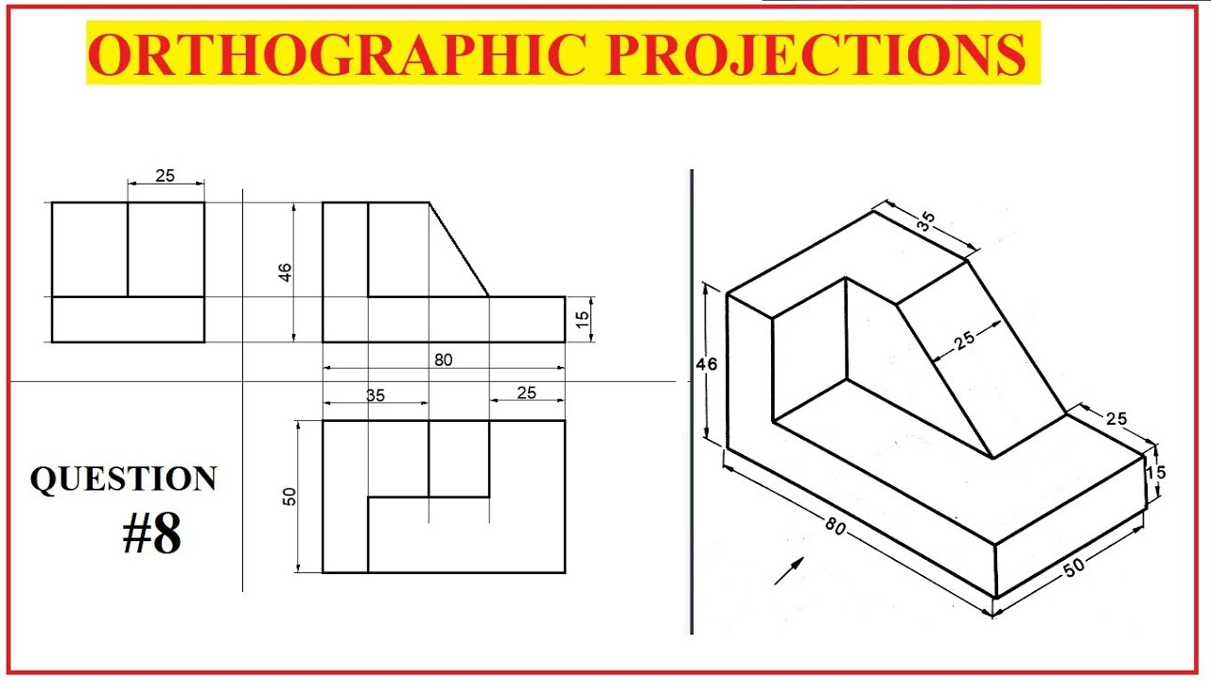
Engineering Graphics
www.anubhavtrainings.com
7

Slide 17
CDS view - projection
No special annotations
ABAP Program
@OData.publish
Fiori Application
CDS entities
@Analytics
@AnalyticDetails
Analytical Apps
@ObjectModel
Transactional App
@VDM
@Analytics
@Odata
@DefaultAggregation
Embedded analytics / SAC
@Odata
Integration API
www.anubhavtrainings.com
7

Slide 18
VDM – Virtual data modeling
VDM is not mandatory, even if you skip VDM, your view/entities are just fine. This is a gold standard or Best Practice to create cds entities in SAP S/4HANA solution. It brings the standardization to our CDS development and increase reusability of our views.
If a colleague build cds views in a company and take holiday or leave the company, how would we know the purpose this view?
When SAP deliver standard CDS views to us, SAP do not provide the mobile number of their developers, so how you know whether you can reuse their view or not?
We need to follow common naming convention in a project as a best practice.
We need to avoid creating duplicate views for same purpose.
VDM is a technical guidance for S/4HANA CDS developers
It is represented by annotation @VDM which is kept at the top of the view
VDM classify our views in different categories as explained in next slide.
www.anubhavtrainings.com
7

Slide 19
Interface Views
VDM
Private Views
Consumption views
Basic
Composite
Starts with P_
We should never use this view to build a View on View
We should never reuse this view
Because a developer who created is trying to convey that, this view contract can change anytime
@VDM.private: true
Starts with C_
Are mainly used for final consumption in Analytic tools, or Apps
SAP deliver 100s of consumption views which become the backbone for S/4HANA embedded analytics
Consumption view is built on top of I views
We also control authorization or odata
@VDM.viewType: #CONSUMPTION
Starts with I_
They are actually used for Reuse purpose. You can freely use them in your own views.
SAP delivers standard Interface views
These views are built on top of I, P, or tables
Basic interface view is solely created using Pure master, Pure Transaction data, @VDM.viewType: #BASIC
Composite view is combination of master and transaction data
@VDM.viewType: #COMPOSITE
www.anubhavtrainings.com

Slide 20
Design process
Fiori App
SAC
S4 Embedded Analytics
APIs
Third Party
Consumption View
Consumption View
Consumption View
Composite Inf.
Composite Inf.
Basic Inf.
Basic Inf.
Basic Inf.
Basic Inf.
Basic Inf.
Basic Inf.
Private views
Private views
Table
Table
Table
Table
Table
Table
www.anubhavtrainings.com
7

Slide 21
Title
<content>
www.anubhavtrainings.com
7

Slide 22
www.anubhavtrainings.com
Thank You
End of Day 2
www.anubhavtrainings.com

Slide 23


We’re committed to empower you to be
#FutureReady
through powerful training solutions.
We build the workforce of the future.
250+
Corporate Clients
30,000+
Learners Trained
25000+
Learners Placed
FREE WEBINARS
Sign up for free webinars with industry experts every fortnight!
Enroll Now!
Contact us today!
https://anubhavtrainings.com

